Slide 1
Comments
Clean CODE-CHAPTER 4

Slide 2
Comment
Everything the Compiler Needs to Know is in the Code!"
Effective comments do not repeat the code they explain the code at higher level.

Slide 3
Comments
Nothing can be quite so helpful as a well-placed comment. Nothing can clutter up a module more than frivolous dogmatic comments. Nothing can be quite so damaging as an old comment that propagates lies and misinformation.
Notes:
This statement highlights the potential harm caused by outdated or inaccurate comments within a codebase. When a comment contains incorrect information or reflects an outdated understanding of the code's functionality, it can mislead developers who rely on it to understand how the code works

Slide 4
Comments Do Not Make Up for Bad Code
Clear and expressive code with few comments is far superior to cluttered and complex code with lots of comments. Rather than spend your time writing the comments that explain the mess you’ve made, spend it cleaning that mess.

Slide 5


Comments focus on Why rather than How?

Slide 6
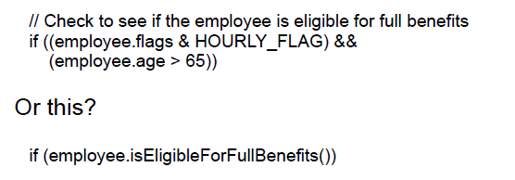
Comments Do Not Make Up for Bad Code

Slide 7
Good Comments
Some comments are necessary or beneficial. However the only truly good comment is the comment you found a way not to write.

Slide 8
Legal Comments
Sometimes our corporate coding standards force us to write certain comments for legal reasons. For example, copyright and authorship statements are necessary and reasonable things to put into a comment at the start of each source file.
/* * Copyright (c) [year] [company name]. All rights reserved. * This software is the confidential and proprietary information * of [company name] ("Confidential Information"). * You shall not disclose such Confidential Information and * shall use it only in accordance with the terms of the * license agreement you entered into with [company name]. */
Notes:
Good Comments
Legal Comments
Necessary for legal or corporate reasons, such as copyright and confidentiality disclaimers.
Informative Comments
Explain important details not obvious from the code, such as the purpose of methods or constants.
Examples:
Explaining conversion factors.
Indicating expected ranges for variables.
Clarification Comments
Provide context for ambiguous units or data types, e.g., specifying units like meters or seconds.
Warnings
Highlight potential risks or consequences, such as performance issues in certain scenarios.
To-Do Comments
Indicate unfinished tasks or planned enhancements in the code, e.g., using //TODO.
Amplification
Emphasize the importance of seemingly minor details, such as explaining why a particular operation is critical.

Slide 9
Informative Comments
It is sometimes useful to provide basic information with a comment. For example, consider this comment that explains the return value of an abstract method:
// Returns an instance of the Responder being tested.
protected abstract Responder responderInstance();

Slide 10
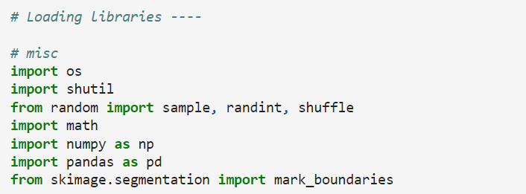
Informative Comments

Slide 11
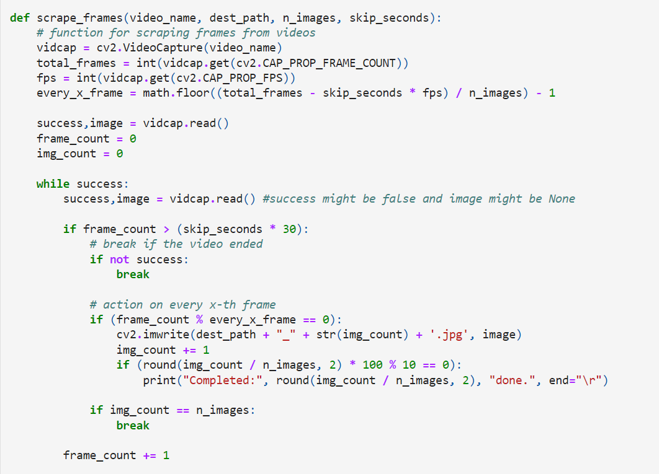
Informative Comments
Notes:
Good Comments
Legal Comments
Necessary for legal or corporate reasons, such as copyright and confidentiality disclaimers.
Informative Comments
Explain important details not obvious from the code, such as the purpose of methods or constants.
Examples:
Explaining conversion factors.
Indicating expected ranges for variables.
Clarification Comments
Provide context for ambiguous units or data types, e.g., specifying units like meters or seconds.
Warnings
Highlight potential risks or consequences, such as performance issues in certain scenarios.
To-Do Comments
Indicate unfinished tasks or planned enhancements in the code, e.g., using //TODO.
Amplification
Emphasize the importance of seemingly minor details, such as explaining why a particular operation is critical.

Slide 12
Clarification –Comments the unit of Numeric data
Numeric data can be in:
Inches, feet, meters, kilometer(length)
Seconds, milliseconds(time)
Radians, degree
These units are not obvious for new programmers also not when the program has been modified.
// Conversion factor from Celsius to Fahrenheit
private static final double CELSIUS_TO_FAHRENHEIT = 9.0 / 5.0;
Notes:
Good Comments
Legal Comments
Necessary for legal or corporate reasons, such as copyright and confidentiality disclaimers.
Informative Comments
Explain important details not obvious from the code, such as the purpose of methods or constants.
Examples:
Explaining conversion factors.
Indicating expected ranges for variables.
Clarification Comments
Provide context for ambiguous units or data types, e.g., specifying units like meters or seconds.
Warnings
Highlight potential risks or consequences, such as performance issues in certain scenarios.
To-Do Comments
Indicate unfinished tasks or planned enhancements in the code, e.g., using //TODO.
Amplification
Emphasize the importance of seemingly minor details, such as explaining why a particular operation is critical.

Slide 13
Comment the range of allowable numeric values
If a variable has an expected range of values, document the expected range.
If your language doesn’t support that capability (and most languages don’t), use a comment to document the expected range of values.
For example, if a variable represents an amount of money in dollars, indicate that you expect it to be between $1 and $100. If a variable indicates a voltage, indicate that it should be between 105v and 125v.
// Amount of money in dollars (Expected range: $1 to $100)
private double moneyInDollars;

Slide 14
Comment limitations on input data
Make sure that expected and unexpected values are documented.
Comments are one way of documenting that a routine is never supposed to receive certain data.
// Note: This value should always be positive and less than or equal to 100.
// Values outside this range may lead to unexpected behavior.
private int batchSize;

Slide 15
Warning
Sometimes it is useful to warn other programmers about certain consequences.
// Don't run unless you
// have some time to kill.
public void _testWithReallyBigFile() {
writeLinesToFile(10000000);
response.setBody(testFile);
response.readyToSend(this);
String responseString = output.toString();
assertSubString("Content-Length: 1000000000", responseString);
assertTrue(bytesSent > 1000000000);
}
Notes:
The comment preceding the method serves as a warning to other programmers. It indicates that running this method might consume a significant amount of time due to its potentially resource-intensive operations

Slide 16
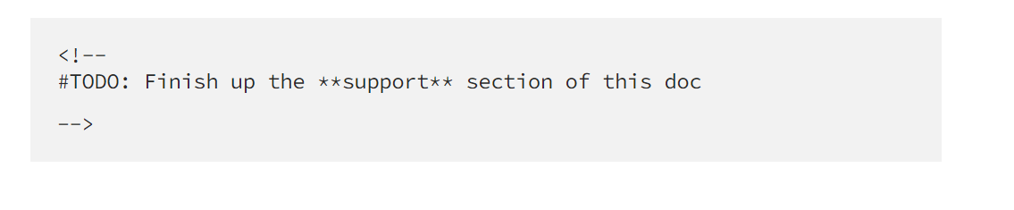
ToDO Comments
It is sometimes reasonable to leave “To do” notes in the form of //TODO comments. In the following case, the TODO comment explains why the function has a degenerate implementation and what that function's future should be.

Slide 17
Amplification
A comment may be used to amplify the importance of something that may otherwise seem inconsequential.
String listItemContent = match.group(3).trim();
// the trim is real important. It removes the starting
// spaces that could cause the item to be recognized
// as another list.
new ListItemWidget(this, listItemContent, this.level + 1);
return buildList(text.substring(match.end()));

Slide 18
Bad Comments
Most comments fall into this category. Usually they are crutches or excuses for poor code or justifications for insufficient decisions, amounting to little more than the programmer talking to himself.

Slide 19
Mumbling
Plopping in a comment just because you feel you should or because the process requires it, is a hack. If you decide to write a comment, then spend the time necessary to make sure it is the best comment you can write. "Plopping a comment" typically refers to the act of adding a comment to code without much consideration or thoughtfulness. It implies that the comment is inserted hastily or without providing meaningful context or value to the code.Example:
public void loadProperties() {
try {
String propertiesPath = propertiesLocation + "/" + PROPERTIES_FILE;
FileInputStream propertiesStream = new FileInputStream(propertiesPath);
loadedProperties.load(propertiesStream);
}
catch(IOException e) {
// No properties files means all defaults are loaded
}
}
Notes:
Lack of Specificity: The comment is quite vague and doesn't clearly explain what "all defaults" refer to. It leaves room for interpretation and may not adequately convey the precise actions taken when no properties file is found.
Assumption of Understanding: The comment assumes that the reader understands what "all defaults" means in this context. However, without further explanation or context, it may not be immediately clear to all developers what defaults are being referred to and how they are loaded.
Incomplete Explanation: The comment doesn't provide information on how the default properties are determined or where they are sourced from. Without this information, developers may have difficulty understanding the logic behind the fallback behavior.

Slide 20
Redundant Comments
What purpose does this comment serve? It’s certainly not more informative than the code. It does not justify the code, or provide intent or rationale. It is not easier to read than the code. Indeed, it is less precise than the code and entices the reader to accept that lack of precision in lieu of true understanding.
int x = 5; // Assigning 5 to variable x

Slide 21
Redundant Comment
// Loop through the array
for (int i = 0; i < array.length; i++) {
// Get the current element
int currentElement = array[i];
// Process the current element
processElement(currentElement); }

Slide 22
Ugly Code
Often comments are used in locations where code is ugly and they are used to ‘fix’ the code. Don’t try to make a code more beautiful by adding comments. When you have an ugly code you should refactor it and write it in a way that expresses what you are doing there.
When you have a code that cannot be understood, then comments are not the solution. Try to rewrite the code or rename fields and other elements in a way that the reader will understand the action that you are doing there.
In many cases, you can extract a method with a mindful name. The reader will understand very easily what is happening there based on the methods and fields name.

Slide 23
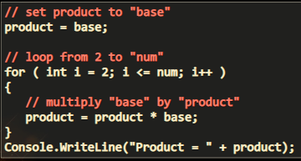
Comment Issues in Code

